Slide 1
Matthew 5:17-48 (ESV)
17 “Do not think that I have come to abolish the Law or the Prophets; I have not come to abolish them but to fulfill them. 18 For truly, I say to you, until heaven and earth pass away, not an iota, not a dot, will pass from the Law until all is accomplished. 19 Therefore whoever relaxes one of the least of these commandments and teaches others to do the same will be called least in the kingdom of heaven, but whoever does them and teaches them will be called great in the kingdom of heaven. 20 For I tell you, unless your righteousness exceeds that of the scribes and Pharisees, you will never enter the kingdom of heaven.

Slide 2
Matthew 5:17-48 (ESV)
Anger
21 “You have heard that it was said to those of old, ‘You shall not murder; and whoever murders will be liable to judgment.’ 22 But I say to you that everyone who is angry with his brother will be liable to judgment; whoever insults his brother will be liable to the council; and whoever says, ‘You fool!’ will be liable to the hell of fire. 23 So if you are offering your gift at the altar and there remember that your brother has something against you, 24 leave your gift there before the altar and go. First be reconciled to your brother, and then come and offer your gift.

Slide 3
Matthew 5:17-48 (ESV)
25 Come to terms quickly with your accuser while you are going with him to court, lest your accuser hand you over to the judge, and the judge to the guard, and you be put in prison. 26 Truly, I say to you, you will never get out until you have paid the last penny.

Slide 4
Matthew 5:17-48 (ESV)
Lust
27 “You have heard that it was said, ‘You shall not commit adultery.’ 28 But I say to you that everyone who looks at a woman with lustful intent has already committed adultery with her in his heart. 29 If your right eye causes you to sin, tear it out and throw it away. For it is better that you lose one of your members than that your whole body be thrown into hell. 30 And if your right hand causes you to sin, cut it off and throw it away. For it is better that you lose one of your members than that your whole body go into hell.

Slide 5
Matthew 5:17-48 (ESV)
Divorce
31 “It was also said, ‘Whoever divorces his wife, let him give her a certificate of divorce.’ 32 But I say to you that everyone who divorces his wife, except on the ground of sexual immorality, makes her commit adultery, and whoever marries a divorced woman commits adultery.

Slide 6
Matthew 5:17-48 (ESV)
Oaths
33 “Again you have heard that it was said to those of old, ‘You shall not swear falsely, but shall perform to the Lord what you have sworn.’ 34 But I say to you, Do not take an oath at all, either by heaven, for it is the throne of God, 35 or by the earth, for it is his footstool, or by Jerusalem, for it is the city of the great King. 36 And do not take an oath by your head, for you cannot make one hair white or black. 37 Let what you say be simply ‘Yes’ or ‘No’; anything more than this comes from evil.

Slide 7
Matthew 5:17-48 (ESV)
Retaliation
38 “You have heard that it was said, ‘An eye for an eye and a tooth for a tooth.’ 39 But I say to you, Do not resist the one who is evil. But if anyone slaps you on the right cheek, turn to him the other also. 40 And if anyone would sue you and take your tunic, let him have your cloak as well. 41 And if anyone forces you to go one mile, go with him two miles. 42 Give to the one who begs from you, and do not refuse the one who would borrow from you.

Slide 8
Matthew 5:17-48 (ESV)
Love Your Enemies
43 “You have heard that it was said, ‘You shall love your neighbor and hate your enemy.’ 44 But I say to you, Love your enemies and pray for those who persecute you, 45 so that you may be sons of your Father who is in heaven. For he makes his sun rise on the evil and on the good, and sends rain on the just and on the unjust. 46 For if you love those who love you, what reward do you have? Do not even the tax collectors do the same? 47 And if you greet only your brothers, what more are you doing than others? Do not even the Gentiles do the same? 48 You therefore must be perfect, as your heavenly Father is perfect.

Slide 9
The King's Manifesto
Matthew 5 to 7

Slide 10
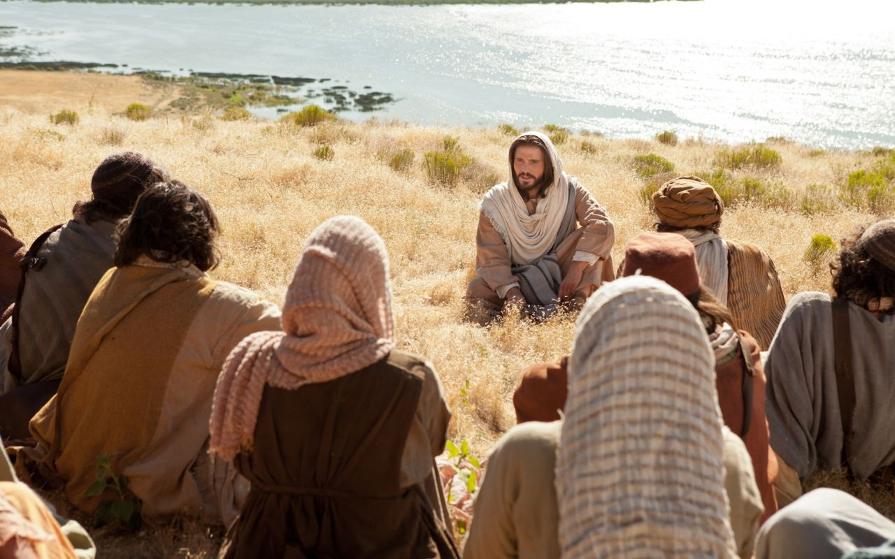
TODAY:
A New Dynamic
Matthew 5:17-48

Slide 11
1. The Law and the King
(verses 17-19)
The Law as it relate to Jesus, the King

Slide 12
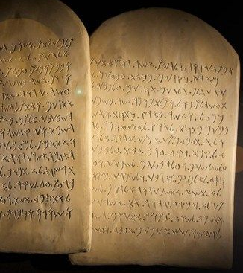
Jesus fulfills the law
"Do not think that I have come to abolish the Law or the Prophets; I have not come to abolish them but to fulfill them”

Slide 13
Jesus fulfills the law
Jesus upholds the law
"For truly, I say to you, until heaven and earth pass away, not a dot, not a tittle, will pass from the Law until all is accomplished"

Slide 14
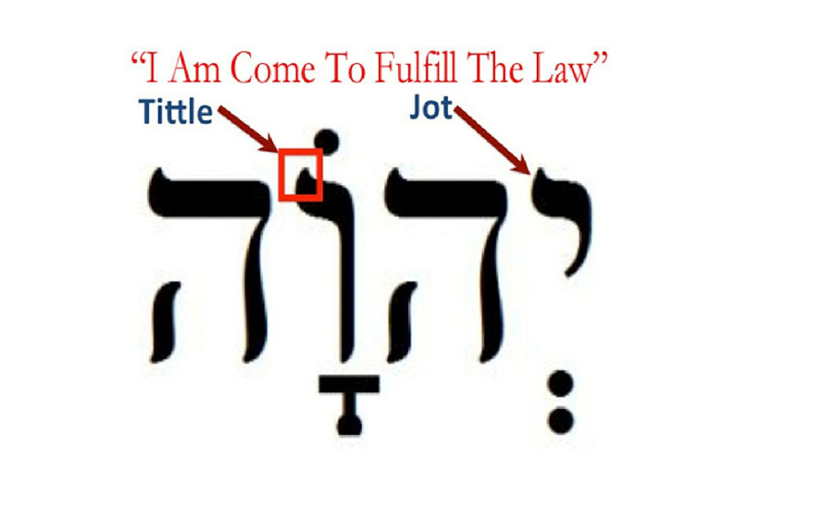

Slide 15
Jesus fulfills the law
“Therefore whoever relaxes one of the least of these commandments and teaches others to do the same will be called least in the kingdom of heaven, but whoever does them and teaches them will be called great in the kingdom of heaven"

Slide 16
How do we relate to the law?
* The law of Moses was given to Israel
* The law reveals the moral nature of God
* The law of Moses was given to reveal sin
* The law of Moses was
given to lead sinners
to faith in Christ

Slide 17
How do we relate to the law?
* The law can never impart righteousness
* The Law no longer has authority over us
* The believer is under a new law -
the Law of Christ

Slide 18
2. The Law and the
Kingdom
(verses 20-48)
The Law as it relates
to those in His kingdom

Slide 19
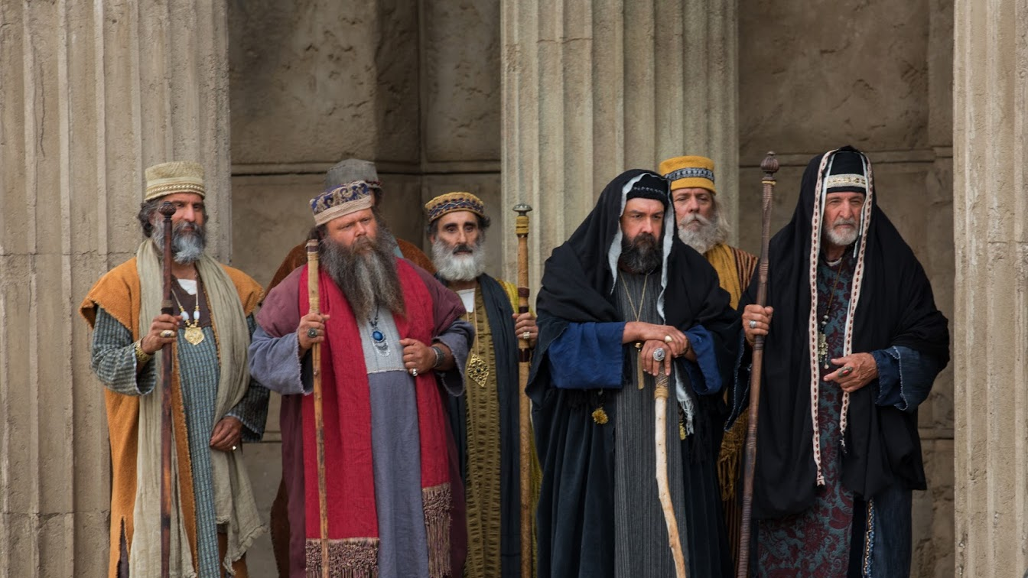
The scribes and Pharisees were regarded as the guardians of the Law

Slide 20
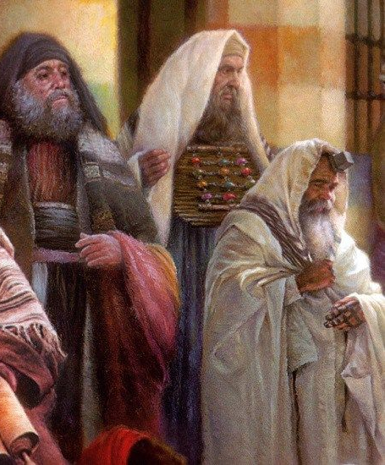
He exposes the superficial keeping of the law
"For I tell you, unless your righteousness exceeds that of the scribes and Pharisees, you will never enter the kingdom of heaven" (verse 20)

Slide 21
"You have heard that it was said to those of old, 'You shall not murder;
and whoever murders will be liable to judgment.' But I say to you that everyone who is angry with his brother will be liable to judgment; whoever insults his brother will be liable to the council; and whoever says, 'You fool!' will be liable to the hell of fire.”
The Law of murder vs. 21-26

Slide 22
"You have heard that it was said, 'You shall not commit adultery.' But I say to you that everyone who looks at a woman with lustful intent has already committed adultery with her in his heart.”
The Law of adultery vs. 27-30

Slide 23
"It was also said, 'Whoever divorces his wife, let him give her a certificate of divorce.' But I say to you that everyone who divorces his wife, except on the ground of sexual immorality, makes her commit adultery, and whoever marries a divorced woman commits adultery.”
The Law of divorce vs. 31-32

Slide 24
"Again you have heard that it was said to those of old, 'You shall not swear falsely, but shall perform to the Lord what you have sworn.' But I say to you, Do not take an oath at all, either by heaven, for it is the throne of God, or by the earth, for it is his footstool, or by Jerusalem, for it is the city of the great King. … Let what you say be simply 'Yes' or 'No'"
The Law of
oaths
vs. 33-37

Slide 25
"You have heard that it was said, 'An eye for an eye and a tooth for a tooth.' But I say to you, Do not resist the one who is evil. But if anyone slaps you on the right cheek, turn to him the other also. And if anyone would sue you and take your tunic, let him have your cloak as well. And if anyone forces you to go one mile, go with him two miles.
The Law of non-
resistance vs. 38-42

Slide 26
He explains the sum of the law
"You have heard that it was said, 'You shall love your neighbour and hate your enemy.' But I say to you, Love your enemies and pray for those who persecute you…” (v. 43-48)

Slide 27
"But I say to you who hear, Love your enemies, do good to those who hate you, bless those who curse you, pray for those who abuse you … love your enemies, and do good, and lend, expecting nothing in return, and your reward will be great, and you will be sons of the Most High, for He is kind to the ungrateful and the evil. Be merciful, even as your Father is merciful" (Luke 6:27-36)

